Slide 1
Amino Acid Chemistry
Learning the chemistry of
Amino Acids by model building.
Created by Ryler Enterprises, Inc.

Slide 2
Introduction to molecular modeling
by Ryler Enterprises.
Ryler makes molecular models
for science classrooms, and for
individual and home study.
Our model kits cover a range of topics in:
Biochemistry
Carbon Allotropes
General Chemistry
Organic Chemistry
Salt Crystals

Slide 3
Table of Contents
Uses
  Building blocks of proteins
  Uses of individual amino acids
Types
Structure
Bonding
Protein Structure

Slide 4
Building Blocks of Proteins
If you had some amino acids, what would you do with them?
You could do what all other living things do with them…

Slide 5

Building Blocks of Proteins
You could make some interesting things!
You could make the proteins that become…
… beautiful red hair!!

Slide 6

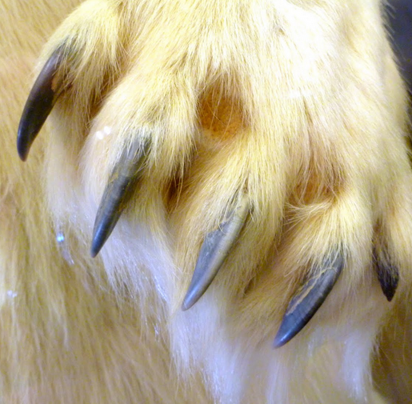
Building Blocks of Proteins
… or if you are a predatory polar bear, you could make some hunting equipment…

Slide 7
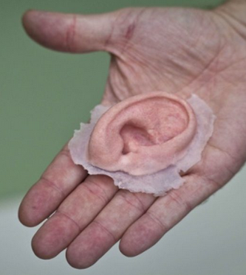
Building Blocks of Proteins
… or make something Mark Antony wanted from his fellow Romans…

Slide 8
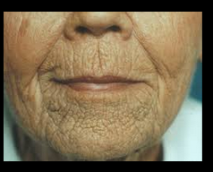

Building Blocks of Proteins
… or make elastic connective tissue in order to avoid…
… this…
… or this!

Slide 9
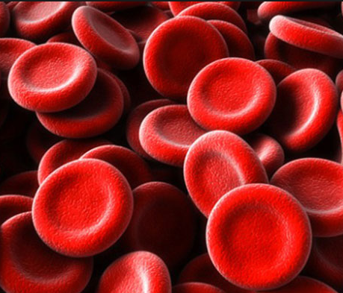

Building Blocks of Proteins
Or, if you are an athlete, you would probably make lots of…
… these…
… and these!

Slide 10
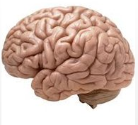
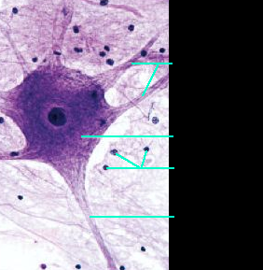
Building Blocks of Proteins
Or, if you are more intellectual, you would make a computer-like one of…
… these…
… filled with lots of these!
Dendrites
Cell body
Supporting cells
Axon

Slide 11
Therefore, amino acids can be used to build proteins, which make cells, tissues, and organs.
Can amino acids do anything else?
Yes, definitely!
In addition to building proteins, amino acids can be used in other ways.

Slide 12
Uses of Individual Amino Acids
Amino acids can be used as an energy source.
However, this is not a good idea.
It would be like tearing apart a house
to use the materials as fuel to heat the house.
Carbohydrates and fats are
better sources of energy.

Slide 13
Uses of Individual Amino Acids
Modified amino acids act as chemical messengers;
  In the brain, serotonin facilitates nerve cell communication.
  In the brain, dopamine facilitates nerve cell communication.
  Lastly, thyroxin from the thyroid gland stimulates the metabolism of all body cells.
.

Slide 14
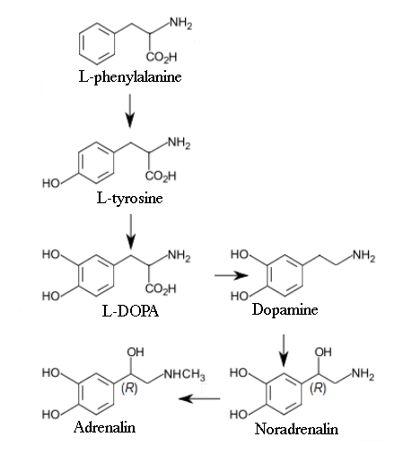
Uses of Individual Amino Acids
The amino acid, phenylalanine, is made into another amino acid: tyrosine. Tyrosine is then made into adrenaline and noradrenalin. These 2 can be used in the “fight or flight” response to danger.

Slide 15
Uses of Individual Amino Acids
The amino acid, tyrosine is also made into melanin, the brown pigment of skin (of every shade), hair (of every color), and eyes (even blue ones).
The artificial sweetener, aspartame, is made in chemical plants by combining 2 amino acids: phenylalanine and aspartic acid.

Slide 16
Types of Amino Acids
There are 20 amino acids that are common
throughout nature. Humans have the ability
to make 11 of these. They are called
nonessential.
The remaining 9 must be eaten.
They are essential in our diets.

Slide 17
Non-essential:
Alanine
Arginine
Asparagine
Aspartic acid
Cysteine
Glutamic acid
Glutamine
Glycine
Proline
Serine
Tyrosine
Essential:
Histidine
Isoleucine
Leucine
Lysine
Methionine
Phenylalanine
Threonine
Tryptophan
Valine

Slide 18
Structure of Amino Acids
Every Amino Acid looks like this.

Slide 19
Structure of Amino Acids
The parts of an alpha Amino Acid:
An acid group.
An NH₂ group.
An α (alpha) carbon.
An R group.
That’s it!!!
All amino acids have these parts,
so are all amino acids exactly the same?
No!! Different amino acids have different R groups.
But parts 1-3 (above) always remain the same.

Slide 20
Structure of Amino Acids
Have you figured out why they are called alpha amino acids?

Slide 21
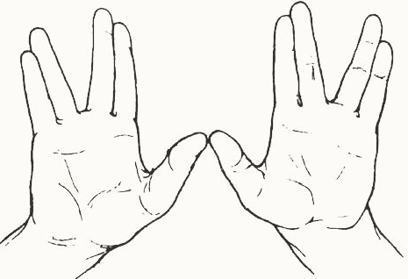
Structure of Amino Acids
Some objects have “handedness.”

Slide 22
The structures of Amino Acids
Handedness just means that an object has a mirror image that cannot be placed on top of the original with all of the parts perfectly aligned.
Try it with your hands.
Put the palm of your right hand on
the back of your left hand.
Do all the parts match exactly?
Is your left thumb where
your right thumb is?

Slide 23
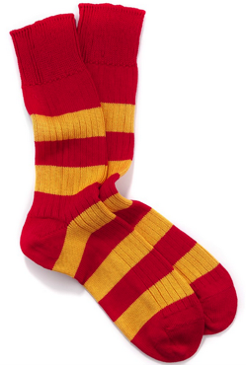
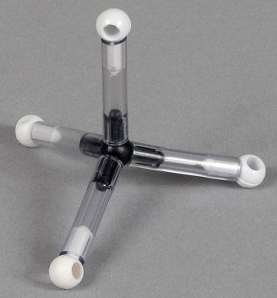
The structures of Amino Acids
Which of these has handedness?
a
b
c

Slide 24
Structure of Amino Acids
“c” is the only object with a mirror image that cannot be aligned perfectly. It has a left handed form and a right handed form.
Here is “c” with the
blue ball on top facing
its mirror image.
Here we try to match
the parts of “c” with
its mirror image.
They don’t match. These models are not the same.

Slide 25
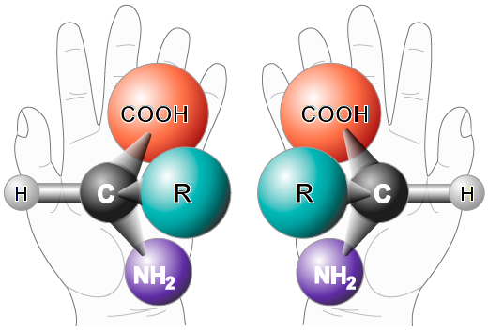
Structure of Amino Acids
Some molecules, such as amino acids, can have handedness.
Left handed
amino acid:
called L
Right handed
amino acid:
called D

Slide 26
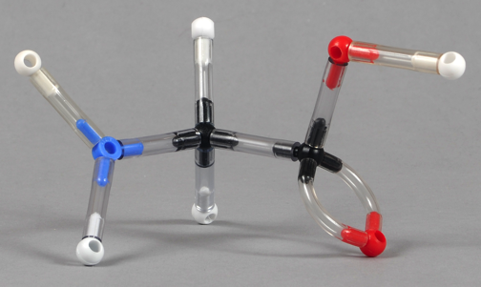
Structure of Amino Acids
Nineteen of the twenty common amino acids are only found naturally existing in the L form.
This is the simplest amino acid, glycine:
Does it have a mirror image?
Is it left handed or right handed?
Make a model of glycine and, if there is one, a mirror image to get the answers.

Slide 27
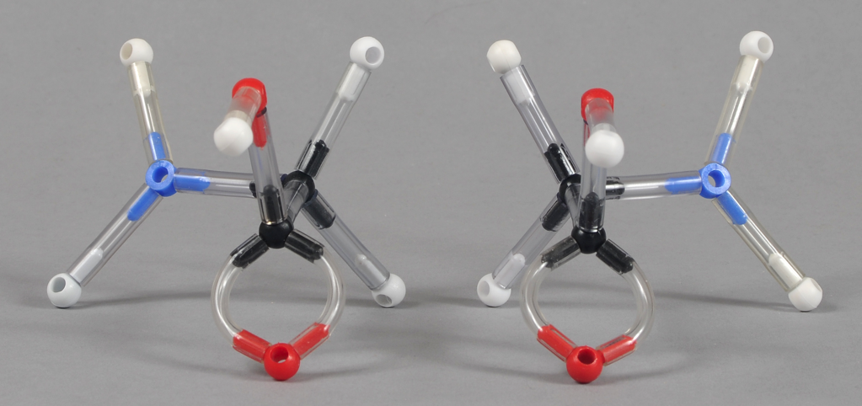
Structure of Amino Acids
Everything* has a mirror image, including glycine.
Glycine on the left; mirror image on the right.
*Vampires do not have mirror images.

Slide 28
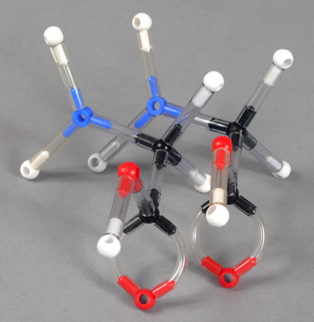
Structure of Amino Acids
Putting the two models of glycine right next to each other shows us that they are exactly the same!
So, glycine has a mirror image, but it is a duplicate of the original.

Slide 29
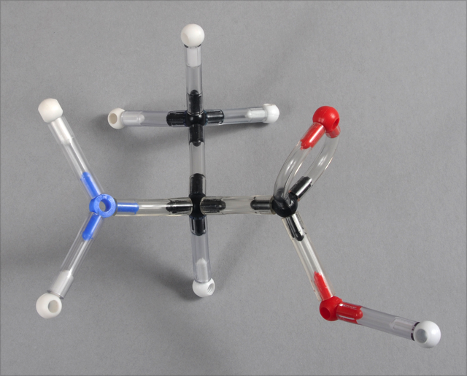
Structure of Amino Acids
This is the next simplest amino acid: alanine.
Make a model of alanine.
Does the model have a mirror image?
Is the model left handed or right handed?

Slide 30
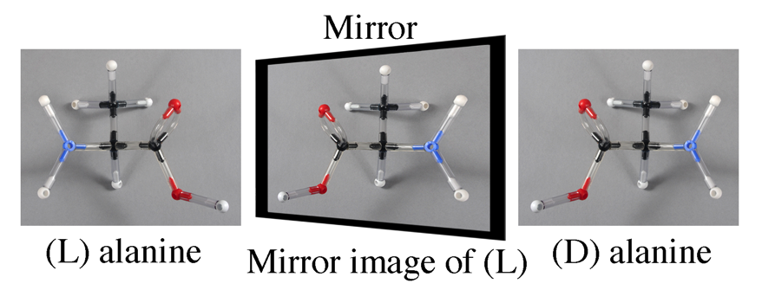
Structure of Amino Acids
Yes, it has a mirror image. The model is the L form.
Notice that the mirror image of the L model, looks like the D model.

Slide 31

Structure of Amino Acids
If you make all of your models of amino acids in this way, they will all be in the L form.
There are 2 ways of diagraming the three dimensionality and handedness of amino acids.

Slide 32
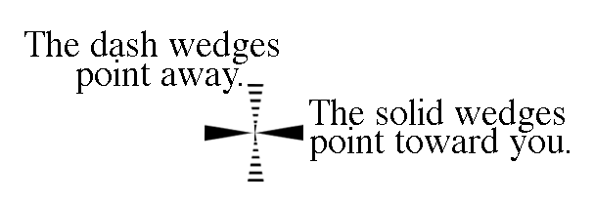
Structure of Amino Acids
The wedges mean the same thing as the horizontal lines on the right. The dashes mean the same thing as the vertical lines on the right.
An α carbon atom is understood to be found at the center where the wedges and lines cross.

Slide 33
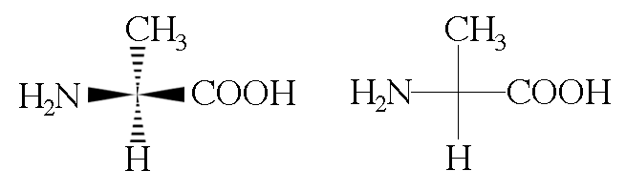
Structure of Amino Acids
The wedge diagram on the left means the same as the line diagram on the right. Here is an example of the same molecule: (L)-α-alanine.

Slide 34
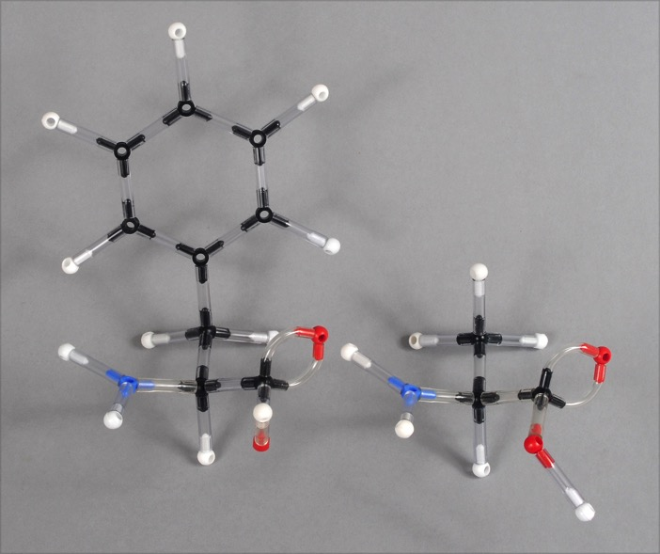
Bonding of Amino Acids
Because amino acids are the building blocks of proteins, we should learn how amino acids bond to one another.
Make this model on the left.
Alanine
Make this model on the right.
Phenylalanine

Slide 35
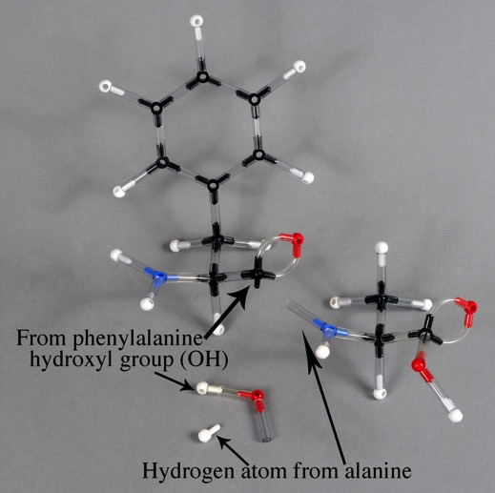
Bonding of Amino Acids
The nitrogen on alanine attacks the acid carbon on phenylalanine.
The –OH pops off the phenylalanine.
While the –H pops off the alanine.

Slide 36
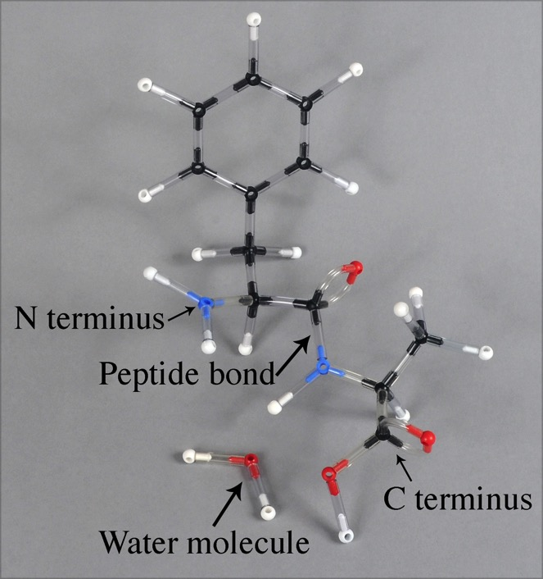
Bonding of Amino Acids
This causes a bond to form between the two amino acids with the loss of a water molecule.
This type of reaction is called a condensation reaction (or dehydration synthesis) since water is a product.

Slide 37

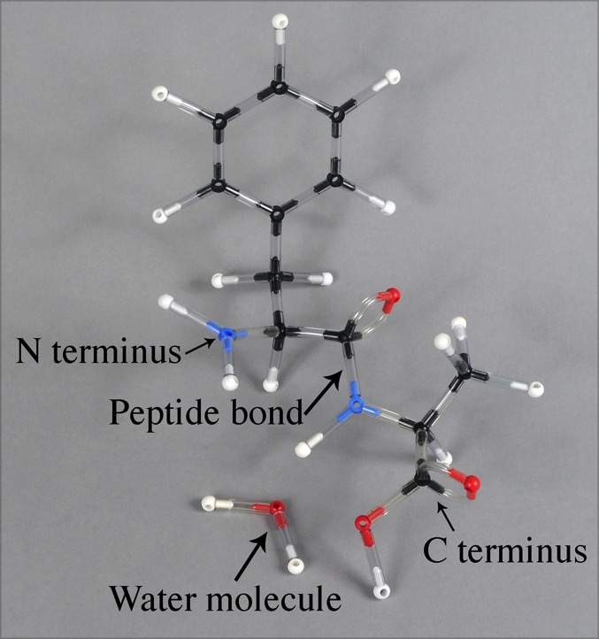
Bonding of Amino Acids
The best way to understand the bonding of two amino acids is to make models while studying this slide.
Before bonding.
After bonding.

Slide 38
Bonding of Amino Acids
Remember, since a water molecule was lost from the joining of two amino acids, it is called a condensation reaction or a dehydration synthesis.

Slide 39
Bonding of Amino Acids
Let’s find out if you picked up some terminology before going on.
What is an N terminus?
What is a C terminus?
What is a peptide bond?
What does a peptide bond connect?

Slide 40
Bonding of Amino Acids
The work you just did produced two amino acids joined together. Two bonded amino acids are called a dipeptide.
Three amino acids bonded together is a tripeptide.
Any more than three would be called a polypeptide.

Slide 41
Protein Structure
Above you can see a strand of amino acids (without the R groups).
This linear layout is the primary structure of a polypeptide (or of a protein).
The symbol used for primary is 1º.

Slide 42
Protein Structure
Peptides and proteins don’t stop arranging their structures at the primary level. They form a right handed coil called an alpha helix, or they form sheets called beta pleated sheets.
This more complex structure is the secondary structure.
The symbol used for secondary is 2º.
Alpha helix

Slide 43
Protein Structure
What holds amino acids together in the 1º structure? That is, what holds the alpha helix in a coil?
Hydrogen bonds are responsible for maintaining the alpha helix.
Alpha helix

Slide 44
Protein Structure
Hydrogen bonds occur when an atom of N, O, or F has a bonded hydrogen atom that becomes shared with another N, O, or F atom.
The dashed lines represent a hydrogen bond.
The nitrogen “owns” the H atom, but is is shared with O.
Alpha helix

Slide 45
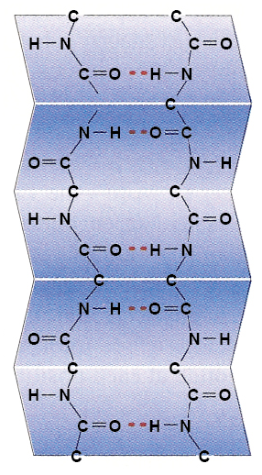
Protein Structure
The other type of secondary structure is the beta (β) pleated sheet, usually just called a beta sheet.
The dashed lines represent
a hydrogen bond.
Beta pleated sheet

Slide 46
Protein Structure
Many proteins have regions of α helices and regions of β sheets in the same molecule.

Slide 47
From the table on the next slide,
pick out two amino acids and build them.

Slide 48
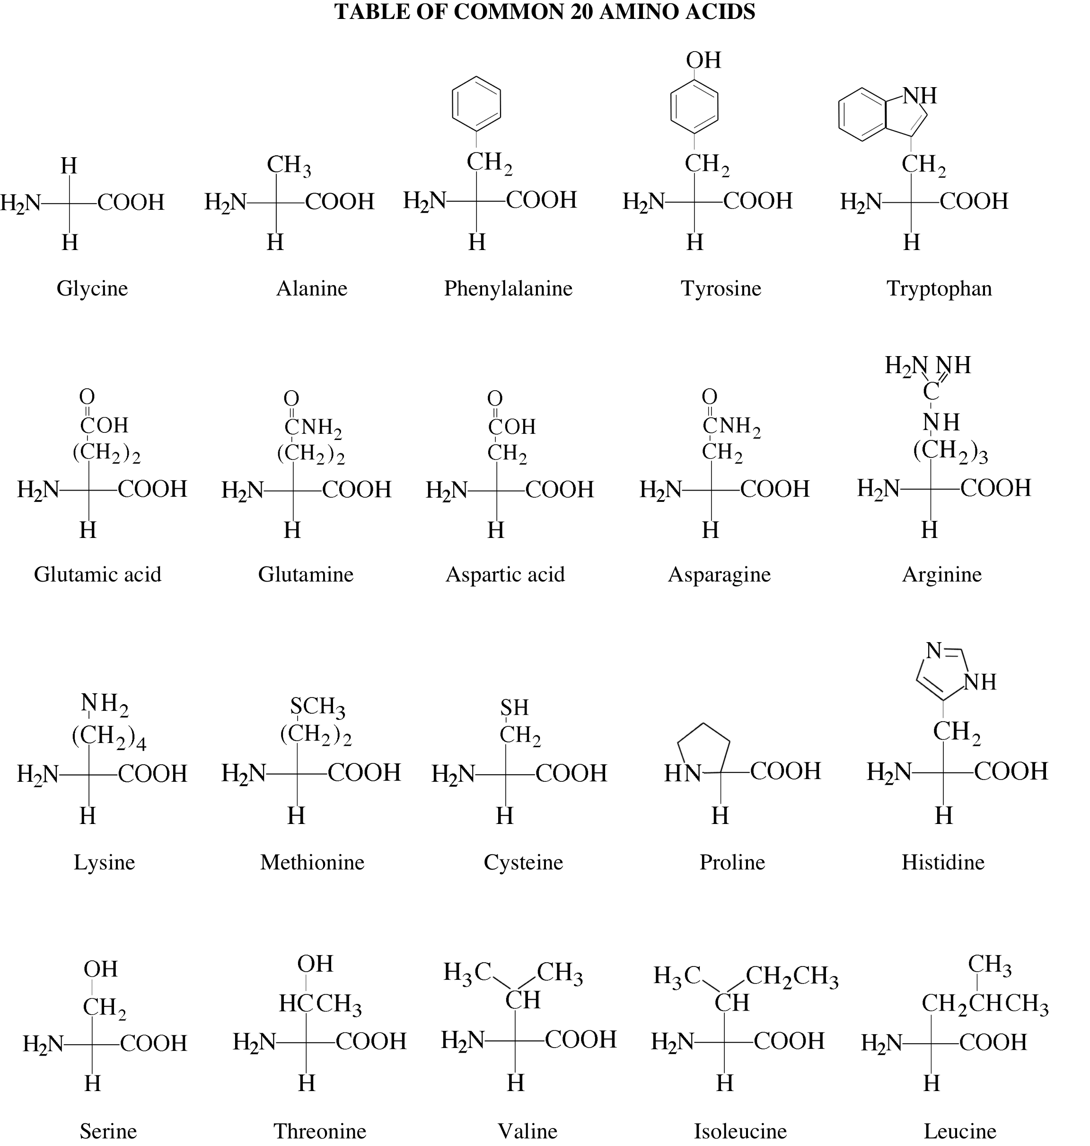

Slide 49
Thank you for choosing Ryler Enterprises for your biology and chemistry education!
For more PowerPoints and PDFs like this one, please visit www.rylerenterprises.com
Other resources on our website include:
Instruction materials
Quizzes
Information for ordering models

